Slide 1
Smart Traffic Management System for Urban Congestion
CSE 7302- University Project
Review-3
Batch Number: CSE_14
Roll Number | Student Name
20221CSE0234 | Syed Thousif
20221CSE0217 | Gajjula Ashok Vardhan Reddy
20221CSE0211 | Kambam Nithin Kumar Reddy
Under the Supervision of,
Ms. Kummara Sruthi
Assistant Professor
School of Computer Science and Engineering
Presidency University
Name of the Program: CSE-Computer Science and Engineering
Name of the HOD: Dr. Asif Mohammed, Dr. Blessed Prince
Name of the Program Project Coordinator: Dr. Jayavadivel Ravi, Mr. Muthuraju V
Name of the School Project Coordinators: Dr. Sampath A K , Dr. Geetha A

Slide 2
Content
Abstract
Objectives
Analysis and Design
Source Code details
Modules
Technologies used
Timeline of the Project (Gantt Chart)
References

Slide 3
Abstract
Increasing traffic congestion and inefficient parking are major challenges in urban areas due to rapid vehicle growth.
Traditional traffic control systems are static and unable to handle real-time traffic conditions effectively.
The proposed Smart AI-Based Traffic and Parking Management System uses machine learning and computer vision technologies.
The system analyzes historical and live traffic data to predict congestion and optimize traffic flow.
Computer vision is used to detect available parking slots in real time.
Users can reserve parking spaces in advance, reducing unnecessary vehicle movement.
The system provides priority routing and signal optimization for emergency vehicles.
Overall, the proposed solution improves traffic efficiency, reduces congestion, enhances parking utilization, and supports smart city transportation initiatives.

Slide 4
Objectives
To ensure high camera quality for capturing clear and detailed visuals under different lighting and weather conditions.
To enable real-time (dynamic time) monitoring for instant detection, processing, and response to on-road situations.
To provide intelligent security alerts by automatically identifying suspicious activities or abnormal events.
To accurately detect and prioritize emergency vehicles (ambulance, fire engine, police) for faster response and traffic management.
To enhance public safety and emergency response efficiency through automated monitoring and alert mechanisms.

Slide 5
Analysis and Design
Analysis
Identified issues: traffic congestion, parking shortage, static signal timing.
Existing systems lack real-time prediction and integrated parking solutions.
Requires AI-based prediction, smart signal control, and live parking updates.
Design
Data Collection: IoT sensors, cameras, GPS, historical data.
Processing & Prediction: Random Forest for congestion forecasting.
Parking Module: Computer vision for slot detection.
Control System: Dynamic signal optimization & emergency priority.
Interface: Real-time updates for users and admin monitoring.

Slide 6
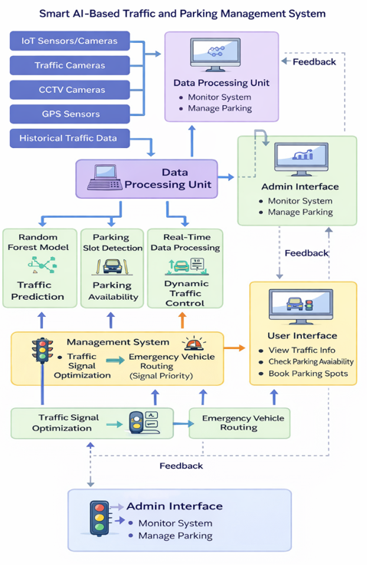
Analysis and Design
System Architecture

Slide 7
Source Code
Main File: • traffic.py – Contains Flask routes, ML logic, parking detection, and templates
Flask Routes: • /register, /login, /logout – User management • / – Dashboard (traffic + parking status) • /predict – Traffic congestion prediction • /parking_status – Parking slot detection • /user_history – View previous predictions
Core Functions: • load_traffic_model() – Load trained Random Forest model • predict_congestion() – Predict traffic level • detect_parking_slots() – OpenCV-based detection • optimize_signal() – Dynamic signal timing • prioritize_emergency() – Emergency vehicle routing
Technologies Used: • Random Forest • OpenCV • Flask • MySQL • NumPy • Pandas

Slide 8
Modules
Data Collection
Traffic Prediction
Parking Detection
Admin Module
User Module
Traffic Prediction
Parking Slot Detection
Route Recommendation
Traffic Signal Optimization
Admin & User Modules

Slide 9
Technologies Used
Programming & Framework
Python
Flask (Web Framework)
Machine Learning
Random Forest Algorithm
Scikit-learn
NumPy & Pandas
Computer Vision
OpenCV
Database
MySQL
Frontend
HTML
CSS
JavaScript
Tools
VS Code
GitHub

Slide 10
Timeline of the Project (Gantt Chart)
Phase | Week 1 | Week 2 | Week 3 | Week 4 | Week 5 | Week 6 | Week 7 | Week 8
1. Requirement Gathering & Analysis | ██████ | ██████
2. Design (UI/UX & Architecture) |  | ██████ | ██████
3. Development (Frontend & Backend) |  |  | ██████ | ██████ | ██████
4. Testing & Debugging |  |  |  |  | ██████ | ██████
5. Deployment & Documentation |  |  |  |  |  |  | ██████ | ██████

Slide 11
References (IEEE Paper format)
[1] Y. Kim, H. Lee, and J. Park, “Deep learning–based adaptive traffic signal control for large-scale urban networks,” IEEE Access, 2026.
[2] S. Rahman and M. Hossain, “Smart traffic congestion prediction using artificial intelligence and IoT,” IEEE Open Journal of Intelligent Transportation Systems, 2026.
[3] M. Rajagopal, R. Sivasakthivel, and G. Anitha, “An intelligent transportation system for traffic flow prediction using graph neural networks,” IEEE Transactions on Intelligent Transportation Systems, 2025.
[4] Y. Huang, Y. Dong, Y. Tang, and L. Li, “Parking availability prediction via fusing multi-source data with a self-supervised learning enhanced spatio-temporal transformer,” IEEE Transactions on Intelligent Transportation Systems, 2025.
[5] C. Zhang, J. Wang, and Y. Liu, “Real-time traffic flow prediction using random forest and sensor data fusion,” IEEE Access, 2025.
[6] S. Alam, M. Luqman, and S. Ali, “Multi-source data-driven traffic congestion detection using artificial intelligence,” IEEE Access, 2025.
[7] R. Abduljabbar, H. Dia, and S. Liyanage, “Machine learning–based traffic flow prediction models for smart and sustainable traffic management,” IEEE Open Journal of Intelligent Transportation Systems, 2024.
[8] A. Rahmani, A. Al-Fuqaha, and M. Guizani, “AI-enabled intelligent traffic signal management for smart cities,” IEEE Access, 2024.

Slide 12
References (IEEE Paper format)
[9] T. Bouraffa, E. Wessman, and A. Nouri, “Vision-based traffic event detection using deep learning,” in Proc. IEEE International Conference on Intelligent Transportation Systems (ITSC), 2024.
[10] L. Falaschetti et al., “Embedded real-time vehicle detection for intelligent traffic control systems,” IEEE Transactions on Intelligent Transportation Systems, 2024.
[11] H. Li, X. Pang, and Z. Chen, “Graph neural networks in intelligent transportation systems: A survey,” IEEE Transactions on Intelligent Transportation Systems, 2023.
[12] W. Wang, R. Patel, and S. Rao, “Reinforcement learning for adaptive traffic signal optimization,” IEEE Intelligent Systems, 2023.
[13] J. Chen, X. Li, and W. Zhang, “Vehicle prioritization using deep learning for real-time traffic signals,” IEEE Transactions on Intelligent Transportation Systems, 2023.
[14] A. Das, S. Roy, and P. Kumar, “Deep learning–based traffic anomaly detection for intelligent transportation systems,” in Proc. IEEE International Conference on Machine Learning and Applications (ICMLA), 2023.
[15] Y. Lv, Y. Duan, W. Kang, Z. Li, and F.-Y. Wang, “Traffic flow prediction with big data: A deep learning approach,” IEEE Transactions on Intelligent Transportation Systems, 2023.

Slide 13


